Slide 1

Advanced Programming CMP 102
Dr. Perihan PEHLİVANOĞLU
Biruni Univarsity
Department of Computer Engineering 2023
Spring

Slide 2
Course Plan
Introduction - Functions (Recursive functions) Arrays, ArrayList, Vector
Collections (List, Queue, Stack, Set, Map, Tree)
Streams, Files
Generics and Exceptions
Midterm Exam

Slide 3
Course Plan
Visual Programming Fundamentals Designing a Form Controls and Forms Properties of Components and Events Final Exam

Slide 4

Last Week
We learned Java Collections.
We made ArrayList and Vector example programs.

Slide 5

Motivation
In this lecture, we will focus on List, Set and Map in Java Collections.
We'll also focus on Stack, Queue, and Tree to prepare you for next year.

Slide 6
Java Collections
The following is the structure of hierarchy collections.

Slide 7
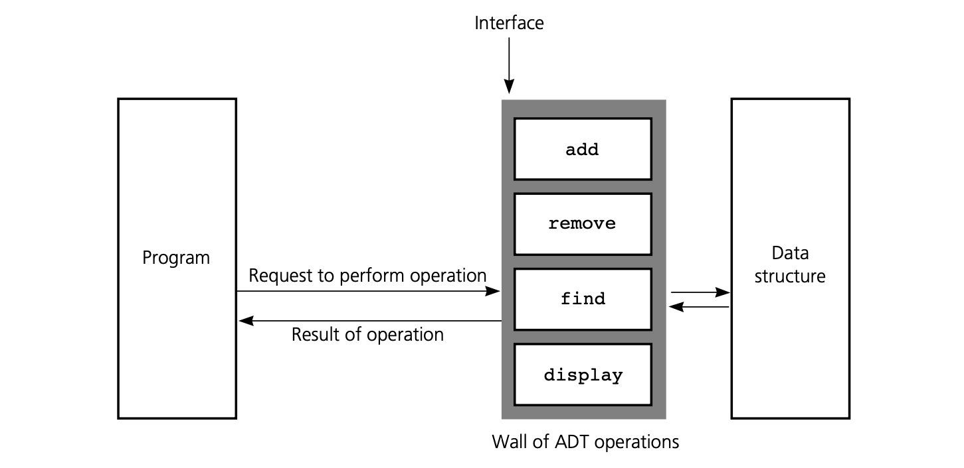
ADT
Data collection is called ADT (Abstract Data Type) with data operations. Collections are used as interfaces.
get
contains

Slide 8
List
Data is added to a list in the order in which data is entered. According to the order of data entry, the index number is used as in the arrays. You can add, delete, access elements to the list. You can create lists using the following libraries. The most commonly used is ArrayList.
java.util.ArrayList
java.util.LinkedList
java.util.Vector
java.util.Stack

Slide 9
List
Create a list
List <String> colorList = new ArrayList <String>();
Add elements to the list
colorList.add("White");

Slide 10
List Example
For example, let's create a list of colors. Let's print the list contents on the console, delete a color, and sort (sorted).

Slide 11
List Example
import java.util.*;
public class {
ColorListProgram
public static void main(String[] args) {
List <String> colorList = new ArrayList <String>();
colorList.add("White");
colorList.add("Blue");
colorList.add("Pink");
colorList.add("Yellow");
System.out.println(colorList);
Collections.sort(colorList);
colorList.remove("Pink");
System.out.println(colorList);
System.out.println(colorList.contains("Yellow"));
}
}
[White, Blue, Pink, Yellow]
[White, Blue, Yellow]
true

Slide 12
Set
A collection is created in the form of a set. There may not be more than one element in a set from the same element. You can create a set using the following libraries.
java.util.HashSet
java.util.LinkedHashSet
java.util.TreeSet

Slide 13
Set
Create a set
Set<String> SetA = new HashSet<>();
Add elements to Set
SetA.add("element 1");

Slide 14
Set Example
For example, let's create a set with 3 elements. Let's delete an employee, let’s search for an employee.

Slide 15
Set Example
import java.util.*;
public class SetExample {
public static void main(String[] args) {
Set<String> SetA = new HashSet<>();
SetA.add("element 1");
SetA.add("element 2");
SetA.add("element 3");
System.out.println(SetA);
SetA.remove("element 2");
System.out.println(SetA);
System.out.println(SetA.contains("element 3"));
}
}
[element 2, element 3, element 1]
[element 3, element 1]
true

Slide 16
Map
With Map, you can map a key to a value. So you can get the value with the key. In other words, it is used to create a dictionary. You can create a map with the following libraries. The most commonly used are HashMap and TreeMap.
java.util.HashMap
java.util.Hashtable
java.util.EnumMap
java.util.IdentityHashMap
java.util.LinkedHashMap
java.util.Properties
java.util.TreeMap
java.util.WeakHashMap

Slide 17
Map
Create a Map
Map<String, String> dictionaryA = new HashMap<>();
Add elements to a map
dictionaryA.put("key1", "element 1");

Slide 18
Map Example
For example, let's define a dictionary as {key1=element 1, key2=element 2, key3=element 3} and create the program that outputs its elements on the console.

Slide 19
Map Example
import java.util.*;
public class MapExample {
public static void main(String[] args) {
Map<String, String> dictionaryA = new HashMap<>();
dictionaryA.put("key1", "element 1");
dictionaryA.put("key2", "element 2");
dictionaryA.put("key3", "element 3");
System.out.println(dictionaryA);
System.out.println(dictionaryA.keySet());
System.out.println(dictionaryA.values());
System.out.println(dictionaryA.containsKey("key2"));
System.out.println(dictionaryA.get(("key1")));
dictionaryA.remove("key2");
System.out.println("\n\n");
dictionaryA.replace("key3", "key555");
for (String key:dictionaryA.keySet())
{String deger= dictionaryA.get(key);
System.out.println(deger);
}
}
}
{key2=element 2, key1=element 1, key3=element 3}
[key2, key1, key3]
[element 2, element 1, element 3]
true
element 1
element 1
key555

Slide 20
Stack

Slide 21
Stack
The Stack data structure is used to operate on a stack. The index of the top item is 1. It is an important topic that you will study in the Data Structures course.
1
2
3
4
FirstElement (ilk eleman)

Slide 22
Stack
Create a stack
Stack<String> stackA = new Stack<String>();
Add elements to the stack
stackA.push("1");

Slide 23
Stack Example
For example, let's create a program that adds elements to the stack and writes its elements to the console.

Slide 24
Stack Example
import java.util.*;
public class StackExample {
public static void main(String[] args) {
Stack<String> stackA = new Stack<String>();
stackA.push("1");
stackA.push("2");
stackA.push("3");
System.out.println(stackA);
int index = stackA.search("3");
System.out.println(index);
System.out.println(stackA.peek());
System.out.println(stackA.firstElement());
}
}
[1, 2, 3]
1
3
1

Slide 25
Queue

Slide 26
Queue
The Queue Data structure is used to serve first-come. You can create this structure using the following libraries.
java.util.LinkedList
java.util.PriorityQueue

Slide 27
Queue
Create a queue
Queue<String> queueA = new LinkedList<>();
Add elements to the queue
queueA.add("element 1");

Slide 28
Queue Example
For example, let's create a program that adds elements to the queue and writes its elements to the console.

Slide 29
Queue Example
import java.util.*;
public class QueueExample {
public static void main(String[] args) {
Queue<String> queueA = new LinkedList<>();
queueA.add("element 1");
queueA.add("element 2");
queueA.add("element 3");
System.out.println(queueA);
System.out.println(queueA.contains("element 2"));
queueA.remove("element 2");
System.out.println(queueA);
System.out.println(queueA.peek());
}
}
[element 1, element 2, element 3]
true
[element 1, element 3]
element 1

Slide 30
Tree
Tree is a special data structure that is used to search and sort it. For example, you remember the game of number prediction. When you estimate the number, you divide the possible numbers by 2 so that you guess the number fast.

Slide 31
Tree
We cannot use the Binary Tree structure ready with Collections. In Data Structures course, you will create a tree data structure.

Slide 32

Assignment - 1
Create a set of book names. Delete the book. Print the book names to the console.

Slide 33
Assignment - 2
Create a dictionary of student name and grade. Search for a student in the dictionary, delete it and print it on the console.

Slide 34
Assignment - 3
Create a queue of people waiting at a bank. Print out who is in the queue and the last person in the queue on the console.

Slide 35
Java Collections
We learned about it fundamentally. You can reach the open resources below to get information about the topic. https://docs.oracle.com/en/java/javase/17/docs/api/java.base/java/util/Collections.html

Slide 36
Next Lecture
We will learn about files and streams.

Slide 37
Uygulama
List
Set
Map
Stack
Queue
We'll perform example programs with collections.

Slide 38
Summary
As a result, we continue to learn about the collections in this week. We have made applications specifically on the Sets, Maps, Queues and Stacks. Be prepared for next lecture. Study it from textbook.

